Slide 1

Team kepler
- Presents digitalization of public transports
- tickets and fares
BY-
ROOBASRI TM Kavinesh
Priya Piyush
Laksan Kumar

Slide 2
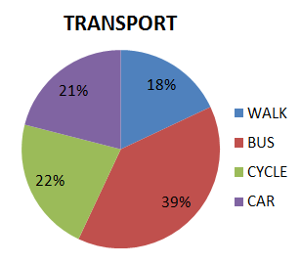
this project Deals with :
The main aspect of raising this topic is to bring about a change which all of us have experienced and are very much aware of, that is usage of Public Transports.
Our prototype not only deals with the booking of bus and auto tickets online being on the bus stand or an Auto-Rikshaw spot but also covers the critical issue of ticket fares.

Slide 3
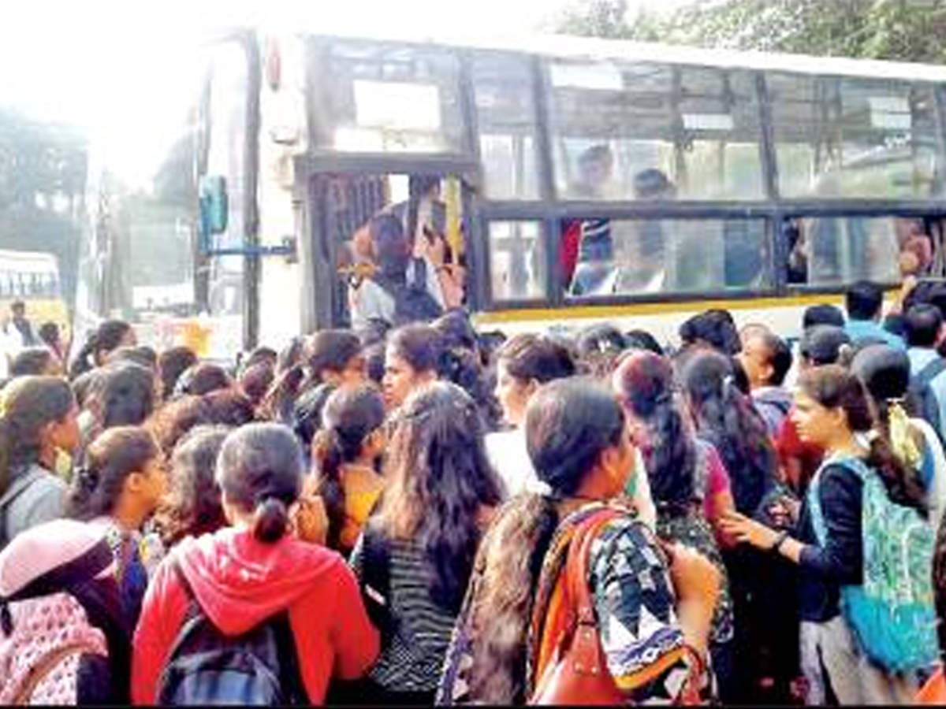
CURRENT SITUATION:
Passengers such as business travelers, tourists and occasional users are often not sufficiently familiar with the public transport system from a city to reach their destination quickly and safely.
Problems faced by urban transport :
Public Transport Crowding
Off-Peak Inadequacy of Public Transport
Difficulties for Pedestrians
Environmental Impact

Slide 4
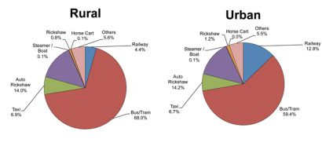
Statistical analysis :
More than 1.6 million buses are registered in India , and the public bus sector operates 170,000 buses carrying roughly 70 million people per day .

Slide 5
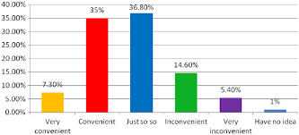
This is the share of people who find it convenient to board a bus

Slide 6
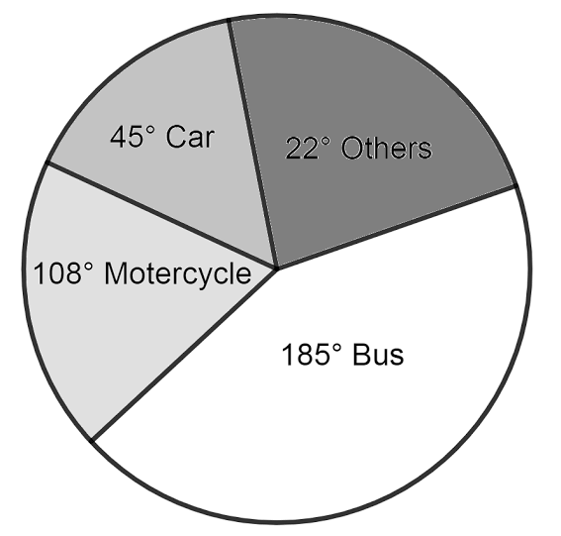
Suggestions
This prototype can reduce the impact of the issue of tickets and convenient fares of tickets in both Rural as well as Urban areas.
Our prototype not only deals with the booking of bus and auto tickets being on the Bus stand or an Auto-rikshaw spot online but it also covers the critical issue of ticket fares .

Slide 7
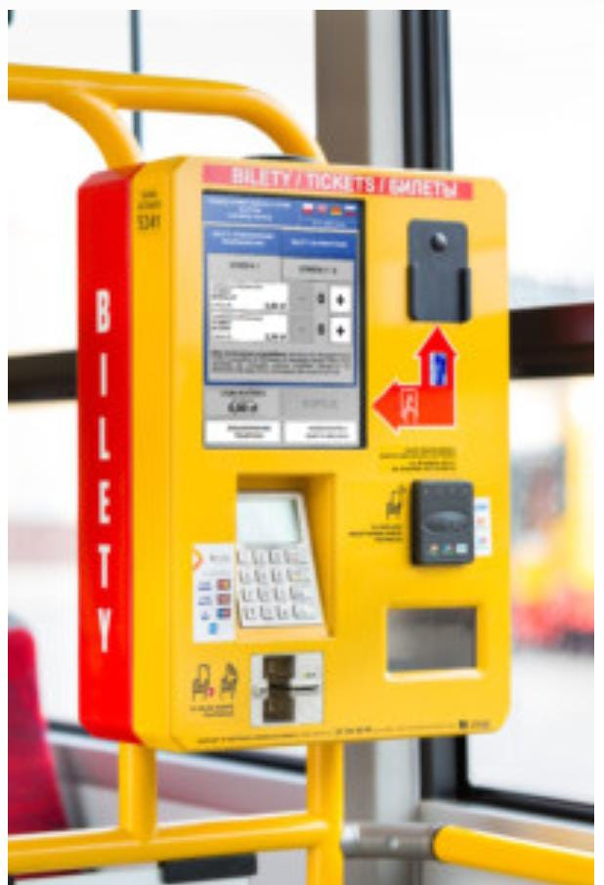
ADVANTAGES :
Mainly introduce to reduce passengers queuing
The task of looking after your machine is unburdened.
The system of ticket purchase is intuitive and clear, so as people of all age can use it.
The tickets sold by drivers are usually more expensive than the automated ones, and the prices in TVMs (Ticket Vending Machine) are usually the standard ones.
These devices are very highly resistant to damage and have a very intuitive interface.

Slide 8
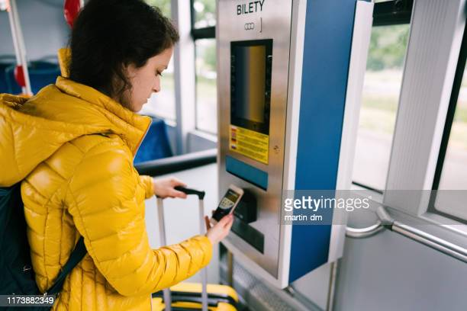
Prototype :
We have 10 functions introduced in our prototype which work as follows
BOOKING A BUS TICKET
ADDING A NEW BUS TO THE RECORDS
SCHEDULE OF ALL BUSES RUNNING
ENQUIRY OF BUS FARES
CANCELING A BUS TICKET
UPDATING FARES
CHANGING BUS TIMINGS

Slide 9
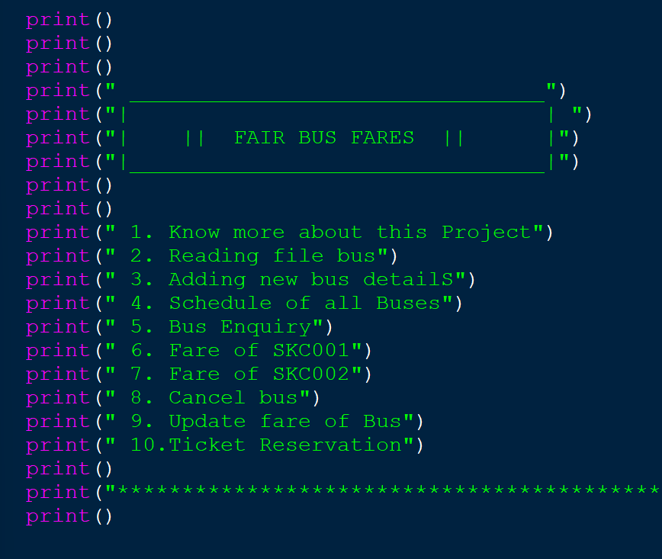
ADDED FUNCTIONS
THE USER CAN GIVE ANY OF THE FOLLOWING INPUTS ACCORDING TO HIS WISHES WHILE BOOKING FOR A BUS.

Slide 10
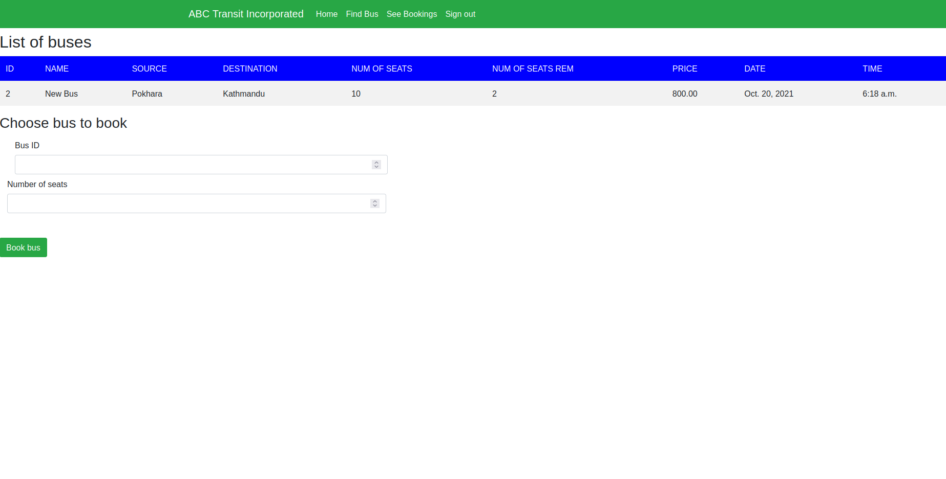
THE INTERFACE FOR BUS BOOKING SITE CAN ACHIEVE MANY BETTER UI/UX SUCH AS THE ABOVE ONE

Slide 11
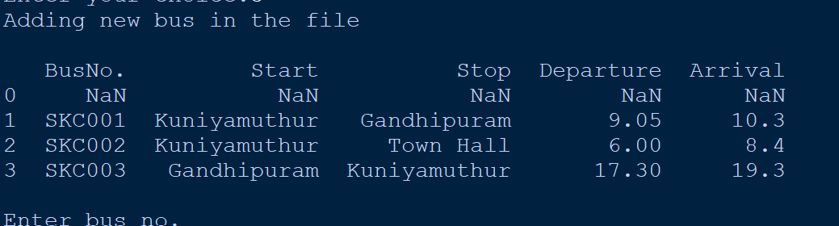
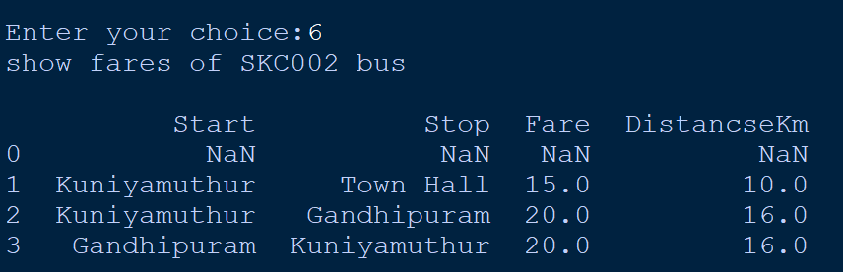
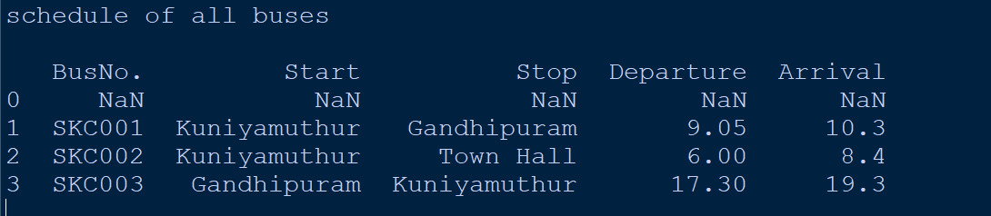
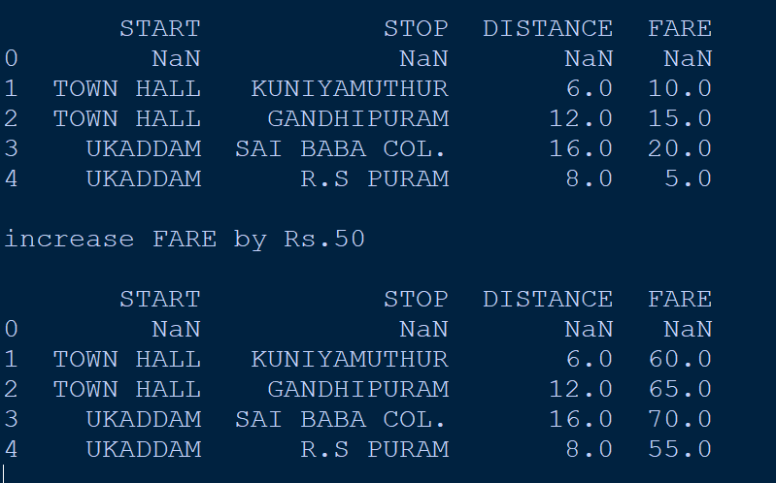
THE VARIOUS INTERFACES OF THE FUNCTIONALITY OF THIS SYSTEM

Slide 12
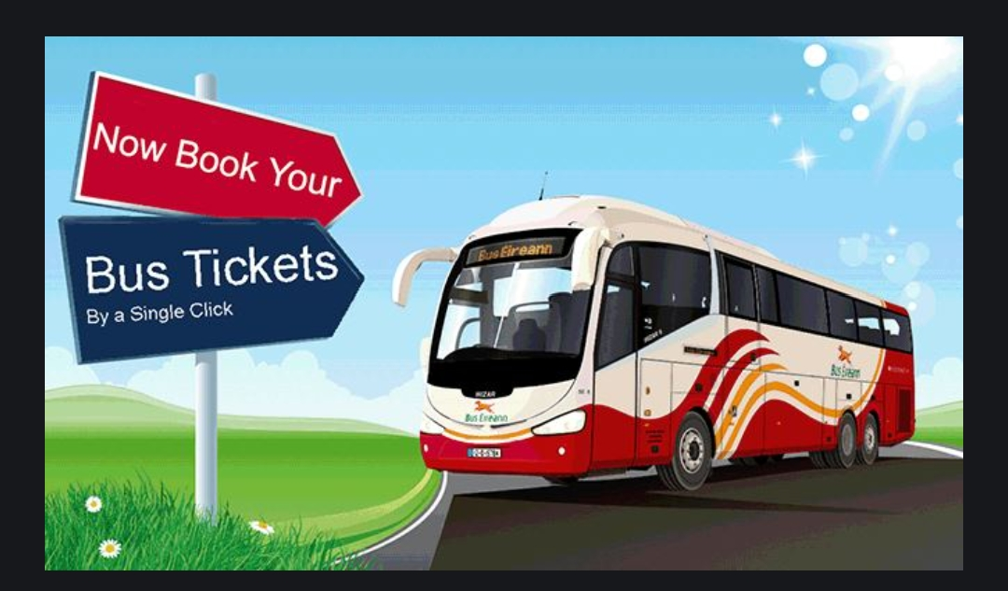
BOOK YOUR TICKETS IN A SINGLE CLICK

Slide 13
THIS IS THE PROTOTYPE PRESENTED BY TEAM KEPLERS FROM ECE DEPARTMENT WHICH DEALS WITH A SIMPLE PROGRAM THAT CAN BE INSTALLED IN A PANEL OF BUS BOOKING SYSTEMS THROUGHOUT THE Z-GEN TO MAKE EVERYTHING COMPATIBLE TO EVERYONE.
-THINK GREEN , KEEP THE ENVIRONMENT CLEAN.

Slide 14
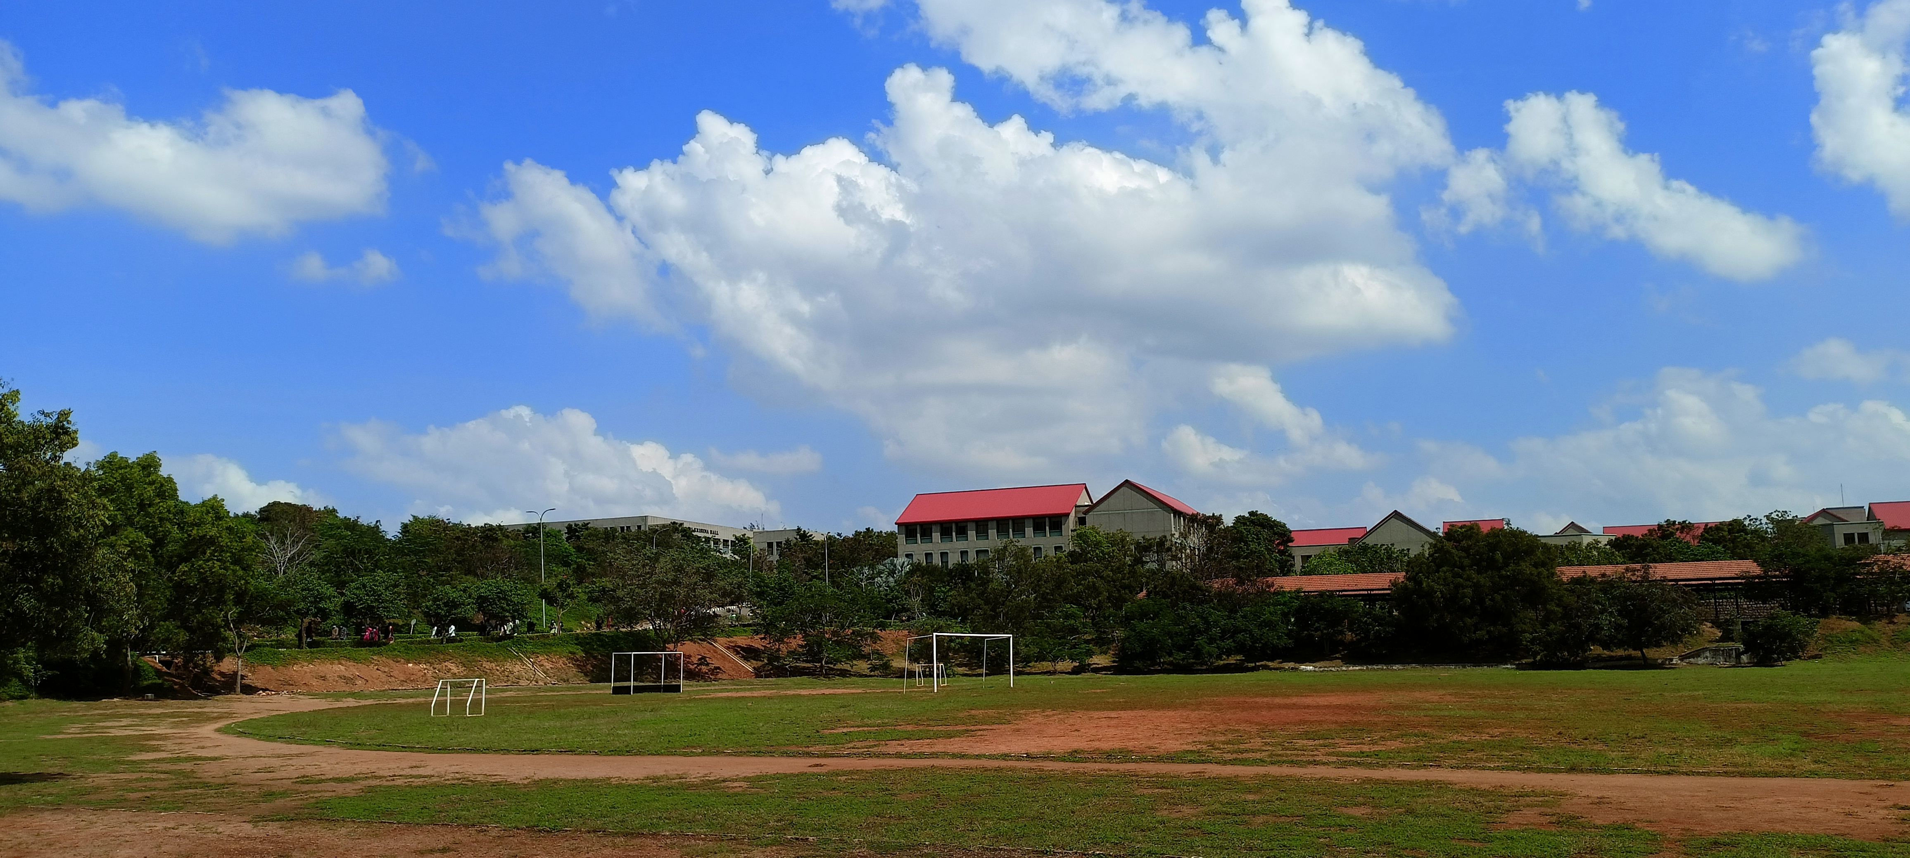
THANK YOU

